Slide 1

Android Resources
Maxim Leykin (maxim.leykin@gmail.com)

Slide 2
Concept of resources

Slide 3

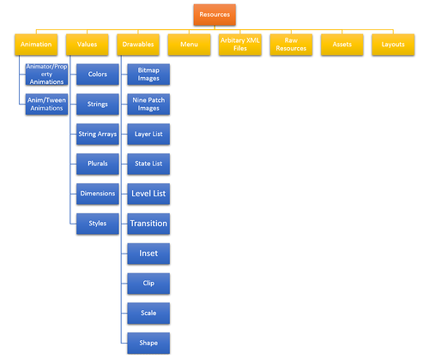
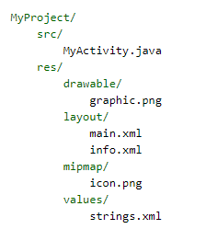
What are resources and where they are located?
Resources are the additional files and static content that your code uses, such as bitmaps, layout definitions, user interface strings, animation instructions, and more.
Types of resources:
values (/res/values)
drawables (res/drawable)
layouts (res/layout)
animations (res/anim)
XML (res/xml)
raw (res/raw)
menu (res/menu)

Slide 4
Main Types of Resources
Directory | Resource Type
anim/ | XML files that define tween animations.
drawable/ | Bitmap files (.png, .9.png, .jpg, .gif) or XML files that are compiled into the following drawable resource subtypes: Bitmap files Nine-Patches (re-sizable bitmaps) State lists Shapes Animation drawables Other drawables
layout/ | XML files that define a user interface layout.
menu/ | XML files that define application menus, such as an Options Menu, Context Menu, or Sub Menu.
xml/ | Arbitrary XML files that can be read at runtime by calling Resources.getXML(). Various XML configuration files must be saved here, such as a searchable configuration.
raw/ | Arbitrary files to save in their raw form. To open these resources with a raw InputStream, call Resources.openRawResource() with the resource ID, which is R.raw.filename.

Slide 5
Main Types of resources
Directory | Resource Type
values/ | XML files that contain simple values, such as strings, integers, and colors. Whereas XML resource files in other res/ subdirectories define a single resource based on the XML filename, files in the values/directory describe multiple resources. For a file in this directory, each child of the <resources> element defines a single resource. For example, a <string> element creates an R.string resource and a <color> element creates an R.color resource. Because each resource is defined with its own XML element, you can name the file whatever you want and place different resource types in one file. However, for clarity, you might want to place unique resource types in different files. For example, here are some filename conventions for resources you can create in this directory: arrays.xml for resource arrays (typed arrays). colors.xml for color values dimens.xml for dimension values. strings.xml for string values. styles.xml for styles.

Slide 6
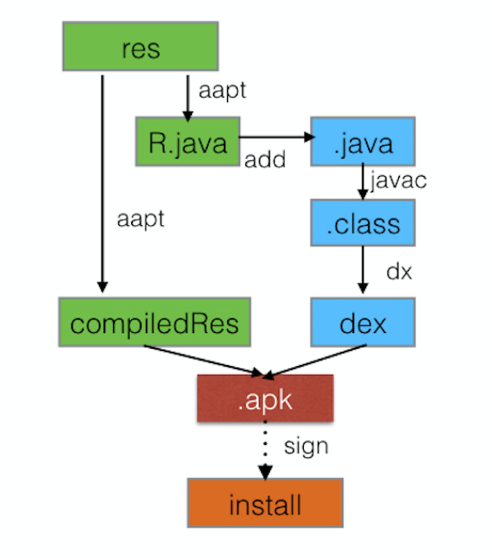
R.java
In compile time all resources are packed to .apk-binary. Special file called R.java, is crated. It contains references to all resources (hexadecimal identifiers) which can be used from Java code. This file is re-generated each time when you re-compile project thus you never need to modify it manually.
For resource identifier you should usually use this syntax form: "@+id/name". The plus symbol, +, indicates that this is a new resource ID and the aapt tool will create a new resource integer in the R.java class, if it doesn't already exist. For example:
<TextView android:id="@+id/nameTextbox"/>
To access resources from code you need to use reference on static class R,
which in turn, contains static nested classes for each type of resource. E.g.
R.string – string resources
R.drawable – pictures
R.id – resources with identifiers
Variables corresponding to resource identifiers are created inside each nested class:
R.string.stop_string
R.drawable.my_image
R.id.nameTextBox

Slide 7
Access to resources
Resources myResources = getResources(); CharSequence styledText = myResources.getText(R.string.stop_message); Drawable icon = myResources.getDrawable(R.drawable.app_icon); int opaqueBlue = myResources.getColor(R.color.opaque_blue); float borderWidth = myResources.getDimension(R.dimen.standard_border); Animation tranOut = AnimationUtils.loadAnimation(this, R.anim.spin); String[] stringArray = myResources.getStringArray(R.array.string_array); int[] intArray = myResources.getIntArray(R.array.integer_array);
From code:
<Button style="@style/LightButton" android:layout_width="@dimen/width" android:layout_height="@dimen/height" android:text="@string/text" android:color="@color/blue"/>
From other resources:
<EditText android:layout_width="match_parent" android:layout_height="wrap_content" android:text="@android:string/httpErrorBadUrl" android:textColor="@android:color/darker_gray"/>
System resources:

Slide 8
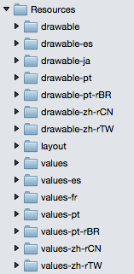
Dynamic Resource Loading
Android allows to provide several variants of the same resource inside the app for different languages, locales, screen sizes, device orientations etc.
Resources will be loaded dynamically depending on device parameters and its changes.
Sub-folder structure inside res folder are created using qualifiers.
When using qualifiers you need to follow some rules:
Qualifiers of different categories must be connected with dash (“-”)
One qualifier per each category
Correct order of qualifiers
Self-Sample: Localization

Slide 9
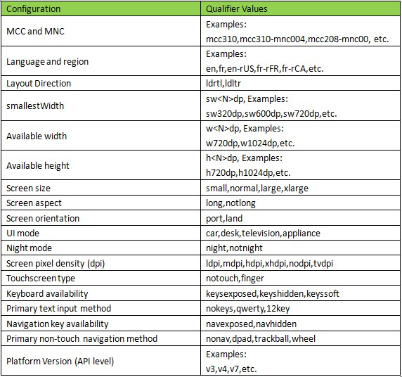
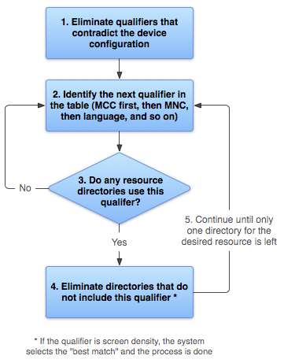
Categories of Qualifiers and Algorithm

Slide 10
Configuration Changes
When configuration changes Android automatically restarts all apps. To avoid this behavior activity can handle config changes manually. To achieve this you need to add attribute android:configChanges to activity description in AndroidManifest.xml.
<activity android:name=".MainActivity" android:label="Test Project" android:configChanges="orientation|screenSize|keyboard">
If one of handled changes has happened method onConfigurationChanged() is called. You can override this method in the app.
@Override public void onConfigurationChanged(Configuration newConfig) { if (newConfig.orientation == Configuration.ORIENTATION_LANDSCAPE) { //TODO: process new orientation } super.onConfigurationChanged(newConfig); }
Self-Sample: Config Changes

Slide 11
Simple resources

Slide 12
Types of Simple Values
strings
colors
dimensions
arrays
attributes
Styles
drawables
<?xml version="1.0" encoding="utf-8"?> <resources> <string name="app_name">To Do List</string> <color name="app_background">#FF0000FF</color> <dimen name="default_border">5px</dimen> <array name="string_array"> <item>Item 1</item> <item>Item 2</item> <item>Item 3</item> </array> <array name="integer_array"> <item>3</item> <item>2</item> <item>1</item> </array> </resources>

Slide 13
Strings
String resources are created with tag <string>
<string name="message">Just a message</string>
HTML is supported inside string resources:
<string name="html_message"><b>Bold message</b></string> <string name="cdata_message"><![CDATA[<b><font color=#F50057>Color message</font></b>]]></string>
You can use string resources with format() call but need to screen ESC symbols:
<string name="formatted_message">%s\n[%s]</string>
To access string resources in code:
String message = getString(R.string.message); Spanned htmlMessage= Html.fromHtml(getString(R.string.html_message)); Spanned cdataMessage= Html.fromHtml(getString(R.string.cdata_message)); String formattedMessage = String.format(getString(R.string.formatted_message), "Hello", "world");

Slide 14
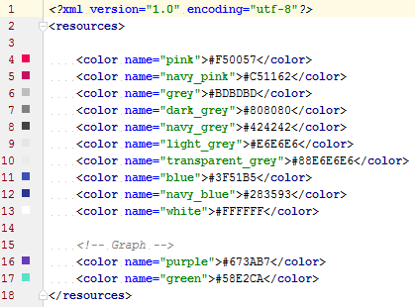
Colors
Color is set by tag <color> and one of 4 schemes:
#RGB
#RRGGBB
#ARGB
#ARRGGBB
where А – alpha, R – red, G – green, B – blue
Example:
<color name="opaque_blue">#00F</color> <color name="transparent_green">#7700FF00</color>

Slide 15
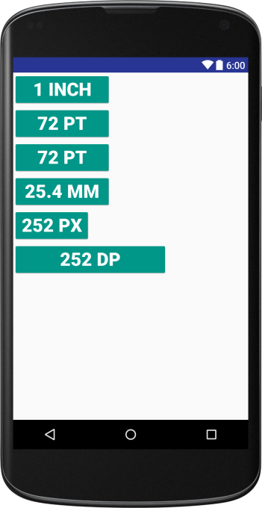
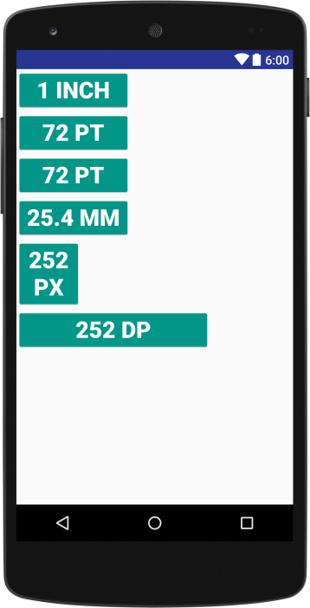
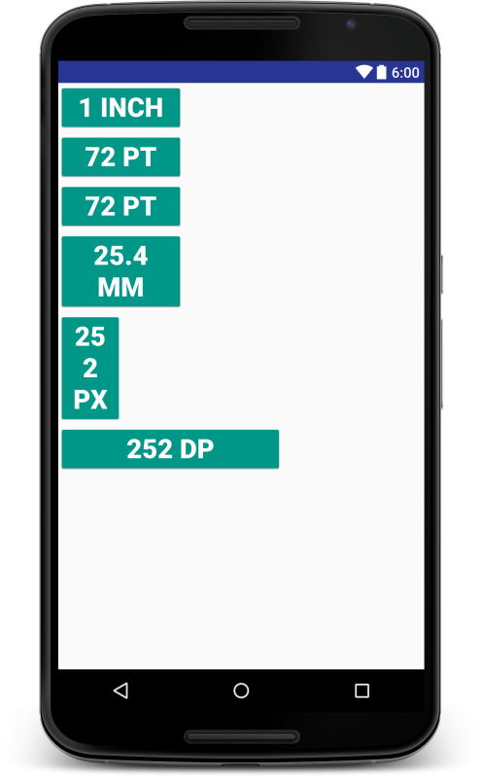
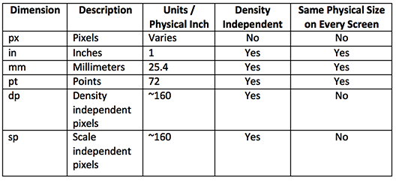
Dimensions
Dimensions are used together with styles and layuouts. They are set with tag <dimen>:
<dimen name="view_padding">40px</dimen> <dimen name="view_width">110dp</dimen>
Use sp for text size…because but it is scaled by the user’s font size preference.
Use dp for everything else.

Slide 16
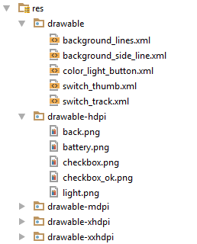
Drawables
A drawable resource is a general concept for a graphic that can be drawn to the screen and which you can retrieve with APIs such as getDrawable(int) or apply to another XML resource with attributes such as android:drawable and android:icon.
Android supports bitmap files in three formats:
.png (preferred)
.jpg (acceptable)
.gif (discouraged)
Android also supports 9-patch, i.e. a PNG file with stretchable regions to allow image resizing based on content (.9.png).
Starting from Android 5.0 Scalable Vector Graphic (SVG) is also supported.
Filename (lowercase, without extension) is a resource identifier:
<ImageButton android:layout_width="wrap_content" android:layout_height="wrap_content" android:src="@drawable/back"/>
Drawable back =
getResources().getDrawable(R.drawable.back, getTheme());

Slide 17
Menu

Slide 18
Menu
Main elements:
<menu> — root element
<group> — container element
<item> — item element
Menu item can have several attributes:
id – menu item identifier
title – menu item text
icon – menu item icon
<menu xmlns:android="http://schemas.android.com/apk/res/android" xmlns:app="http://schemas.android.com/apk/res-auto"> <item android:id="@+id/action_settings" android:orderInCategory="100" android:title="settings" app:showAsAction="never"/> </menu>

Slide 19
Menu
Menu described in XML file is loaded with inflate() method of MenuInflater class. Usually it happens in onCreateOptionsMenu().
Callback onOptionsItemSelected() is used to handle user interaction
@Override public boolean onCreateOptionsMenu(Menu menu) { getMenuInflater().inflate(R.menu.menu_main, menu); return true; } @Override public boolean onOptionsItemSelected(MenuItem item) { int id = item.getItemId(); if (id == R.id.action_settings) { //TODO: show settings return true; } return super.onOptionsItemSelected(item); }

Slide 20
Animations

Slide 21
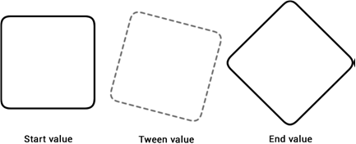
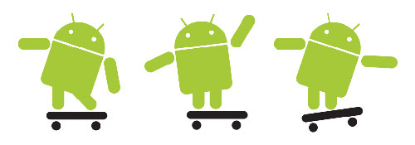
Animations
Two main types of animations
Tween Animation – creates an animation by performing a series of transformations (rotate, scale, etc.) on a single image.
Frame Animation – creates an animation by showing a sequence of images in order.
Note: Animation can be applied to any View object.

Slide 22
Tween Animation
Each tween animation is stored in xml-file under res/anim folder. Animation identifier = filename.
Four types of tween transformations:
alpha – translates the transparency of the view from 0.0 (transparent) to 1.0 (opaque)
rotate – spins the view clockwise or counterclockwise around a pivot point
scale – stretches the view vertically and horizontally from a pivot point
translate – moves the view from one position on the screen to another
Tween animations can be defined programmatically in the Java code or declaratively as XML resource files in the /res/anim folder.
Java classes (package android.view.animation)
- AlphaAnimation - RotateAnimation
- ScaleAnimation - TranslateAnimation
XML elements
- <alpha> – <rotate>
- <scale> – <translate>
It is also possible to define a “set” of transformations to be applied to a view; e.g., rotate and translate.

Slide 23
Tween Animation
<set xmlns:android="http://schemas.android.com/apk/res/android" android:shareInterpolator="false"> <scale
android:interpolator="@android:anim/accelerate_interpolator" android:fromXScale="1.0" android:toXScale="1.4" android:fromYScale="1.0" android:toYScale="0.6" android:pivotX="50%" android:pivotY="50%" android:fillAfter="false" android:duration="700" />
<set android:interpolator="@android:anim/accelerate_interpolator" android:startOffset="700"> <scale android:fromXScale="1.4" android:toXScale="0.0" android:fromYScale="0.6" android:toYScale="0.0" android:pivotX="50%" android:pivotY="50%" android:duration="400" /> <rotate android:fromDegrees="0" android:toDegrees="-45" android:toYScale="0.0" android:pivotX="50%" android:pivotY="50%" android:duration="400" /> </set> </set>

Slide 24
Frame Animation
Sequence of pictures, each frame will be displayed for certain number of milliseconds. Scenario is stored in res/drawable
<?xml version="1.0" encoding="utf-8"?> <animation-list xmlns:android="http://schemas.android.com/apk/res/android" android:oneshot="false"> <item android:drawable="@drawable/rocket_thrust1" android:duration="200"/> <item android:drawable="@drawable/rocket_thrust2" android:duration="200" /> <item android:drawable="@drawable/rocket_thrust3" android:duration="200" /> </animation-list>
ImageView rocketImage = (ImageView) findViewById(R.id.rocket_image); rocketImage.setBackgroundResource(R.drawable.rocket_thrust); AnimationDrawable rocketAnimation = (AnimationDrawable) rocketImage.getBackground(); rocketAnimation.start();
AnimationSample

Slide 25
Views & Layouts

Slide 26
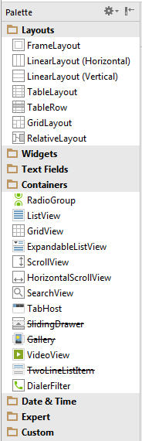
Layout
A layout defines the visual structure for a user interface, such as the UI for an activity or app widget. You can declare a layout in two ways:
Declare UI elements in XML. Android provides a straightforward XML vocabulary that corresponds to the View classes and subclasses, such as those for widgets and layouts.
Instantiate layout elements at runtime. Your application can create View and ViewGroup objects (and manipulate their properties) programmatically.
We’ll use 1st approach. The advantage to declaring your UI in XML is that it enables you to better separate the presentation of your application from the code that controls its behavior.
Each layout is stored in a separate file. Layout ID = filename
<?xml version="1.0" encoding="utf-8"?> <LinearLayout xmlns:android="http://schemas.android.com/apk/res/android" android:orientation="vertical" android:layout_width="match_parent" android:layout_height="fill_parent"> <TextView android:layout_width="match_parent" android:layout_height="wrap_content" android:text="Hello World!"/> </LinearLayout>

Slide 27
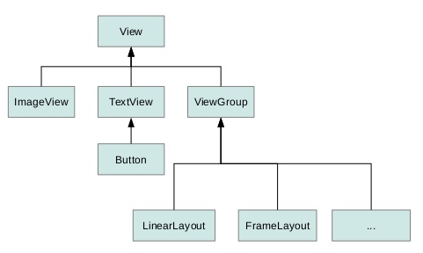
Layout Elements
View – This class represents the basic building block for user interface components. A View occupies a rectangular area on the screen and is responsible for drawing and event handling. View is the base class for widgets, which are used to create interactive UI components (buttons, text fields, etc.)
ViewGroup – A ViewGroup is a special view that can contain other views (called children.) The view group is the base class for layouts and views containers. This class also defines the ViewGroup.LayoutParams class which serves as the base class for layouts

Slide 28
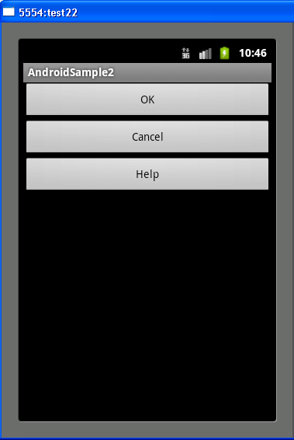
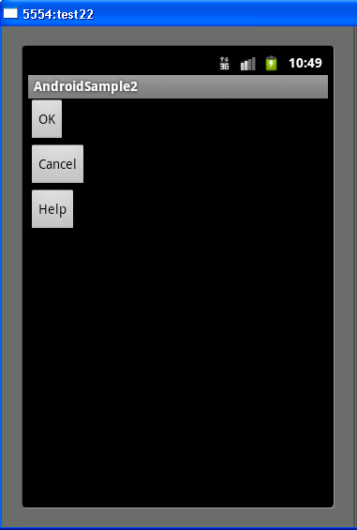
View: fill model
Attributes:
orientation
fill model
paddings
margins
Weight
gravity
Possible values for “fill model”:
exact value (px, dp, in, …) – discouraged!
wrap_content – Setting a View's size to wrap_content will force it to expand only far enough to contain the values (or child controls) it contains. For controls -- like text boxes (TextView) or images (ImageView) -- this will wrap the text or image being shown. For layout elements it will resize the layout to fit the controls / layouts added as its children.
match_parent (fill_parent before API 8) – Setting the layout of a widget to fill_parent will force it to expand to take up as much space as is available within the layout element it's been placed in. It's roughly equivalent of setting the dockstyle of a Windows Form Control to Fill. Setting a top level layout or control to fill_parent will force it to take up the whole screen.

Slide 29
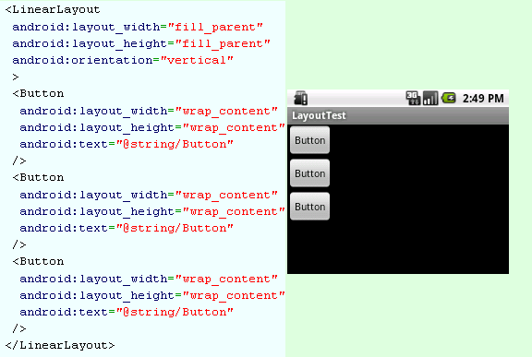
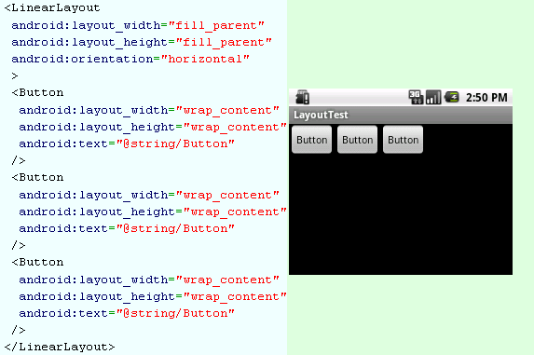
View: orientation
android:orientation = vertical – one column
android:orientation = horizontal – one row

Slide 30
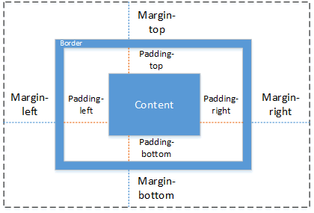
View: paddings and margins

Slide 31
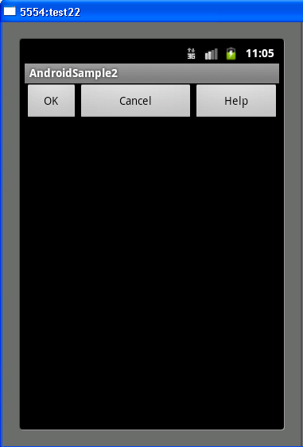
View: weight
<?xml version="1.0" encoding="utf-8"?>
<LinearLayout xmlns:android="http://schemas.android.com/apk/res/android"
android:layout_width="fill_parent"
android:layout_height="fill_parent"
android:orientation="horizontal" >
<Button
android:layout_width="wrap_content“
android:layout_height="wrap_content"
android:layout_weight="1"
android:text="@string/btnOK" />
<Button
android:layout_width="wrap_content“
android:layout_height="wrap_content"
android:layout_weight="3"
android:text="@string/btnCancel" />
<Button
android:layout_width="wrap_content“
android:layout_height="wrap_content"
android:layout_weight="2"
android:text="@string/btnHelp" />
</LinearLayout>

Slide 32
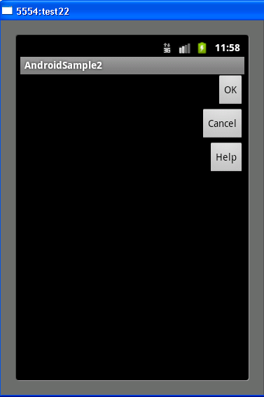
View: gravity
<?xml version="1.0" encoding="utf-8"?>
<LinearLayout xmlns:android="http://schemas.android.com/apk/res/android"
android:layout_width="match_parent"
android:layout_height="match_parent"
android:orientation="vertical" >
<Button
android:layout_width="wrap_content“
android:layout_height="wrap_content"
android:layout_gravity="right"
android:text="@string/btnOK" />
<Button
android:layout_width="wrap_content“
android:layout_height="wrap_content"
android:layout_gravity="right"
android:text="@string/btnCancel" />
<Button
android:layout_width="wrap_content“
android:layout_height="wrap_content"
android:layout_gravity="right"
android:text="@string/btnHelp" />
</LinearLayout>
Sample: LayoutControl
LayoutAttributes

Slide 33
View: Common Methods
setEnabled(boolean enabled)
booelan isEnabled( )
boolean requestFocus( )
boolean isFocused( )
boolean clearFocus( )
getParent( )
getParentOfType( )
findViewById( )
getRootView( )

Slide 34
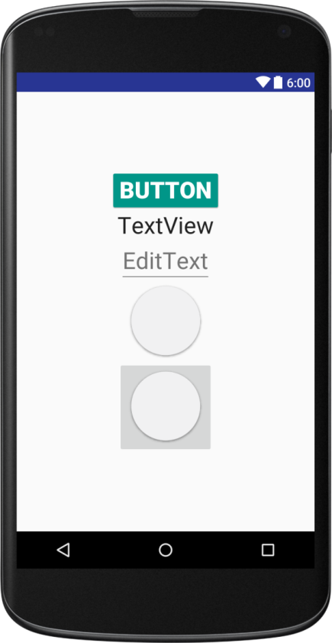
View: Simple Widgets
<Button android:layout_width="wrap_content" android:layout_height="wrap_content" android:text="Button"/> <TextView android:layout_width="wrap_content" android:layout_height="wrap_content" android:textSize="30sp" android:text="TextView"/> <EditText android:layout_width="wrap_content" android:layout_height="wrap_content" android:textSize="30sp" android:hint="EditText"/>
<ImageView android:layout_width="wrap_content" android:layout_height="wrap_content" android:src="@drawable/circle"/> <ImageButton android:layout_width="wrap_content" android:layout_height="wrap_content" android:src="@drawable/circle"/>

Slide 35
Layout Managers
Name | Description
Linear Layout | LinearLayout is a view group that aligns all children in a single direction, vertically or horizontally.
Relative Layout | RelativeLayout is a view group that displays child views in relative positions.
ConstraintLayout | Displays views tight by some constraints to other views
Table Layout | TableLayout is a view that groups views into rows and columns.
Absolute Layout | AbsoluteLayout enables you to specify the exact location of its children.
Frame Layout | The FrameLayout is a placeholder on screen that you can use to display a single view.
List View | ListView is a view group that displays a list of scrollable items.
Grid View | GridView is a ViewGroup that displays items in a two-dimensional, scrollable grid.

Slide 36
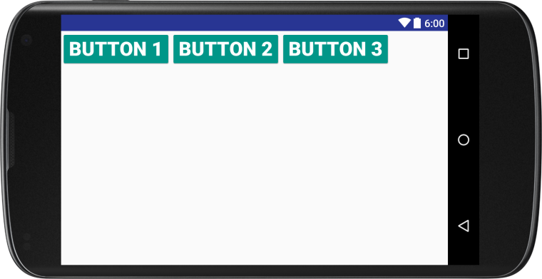
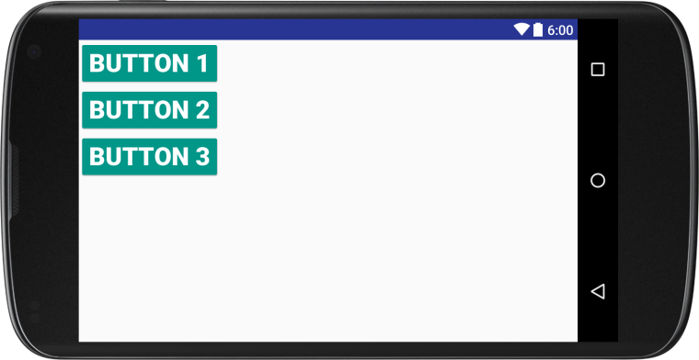
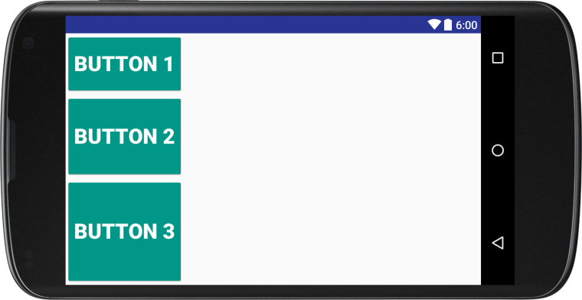
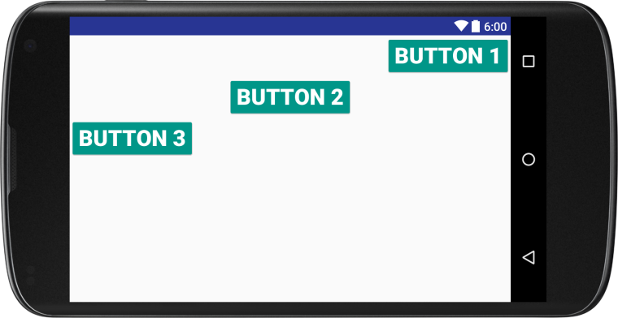
Layout Managers: LinearLayout
Controlled parameters: orientation, weight, gravity
<LinearLayout android:orientation="vertical" android:layout_width="match_parent" android:layout_height="match_parent"> <Button android:layout_width="wrap_content" android:layout_height="wrap_content" android:layout_gravity="end" android:text="Button 1"/> <Button android:layout_width="wrap_content" android:layout_height="wrap_content" android:layout_gravity="center" android:text="Button 2"/> <Button android:layout_width="wrap_content" android:layout_height="wrap_content" android:layout_gravity="start" android:text="Button 3"/> </LinearLayout>

Slide 37
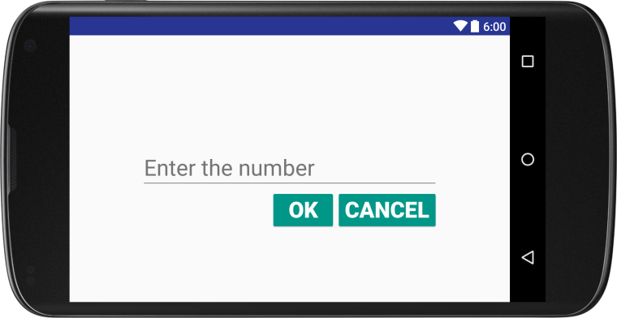
Layout Managers: RelativeLayout
Position of each element is set relatively.
Element position relatively to container:
android:layout_alignParentTop (bottom, right, left)
android:layout_centerHorizontal (vertical)
android:layout_centerInParent
Element position relatively to other elements:
android:layout_above (below, toRightOf, toLeftOf)
android:layout_alignTop (bottom, right, left)
<RelativeLayout android:layout_width="match_parent" android:layout_height="match_parent"> <EditText android:id="@+id/edit" android:layout_width="400dp" android:layout_height="wrap_content" android:hint="Enter the number" android:layout_centerInParent="true" <Button android:id="@+id/cancel" android:layout_width="wrap_content" android:layout_height="wrap_content" android:layout_below="@id/edit" android:layout_alignRight="@+id/edit" android:text="Cancel"/> <Button android:layout_width="wrap_content" android:layout_height="wrap_content" android:layout_below="@id/edit" android:layout_toLeftOf="@id/cancel" android:text="OK"/> </RelativeLayout>
RelativeLayout

Slide 38
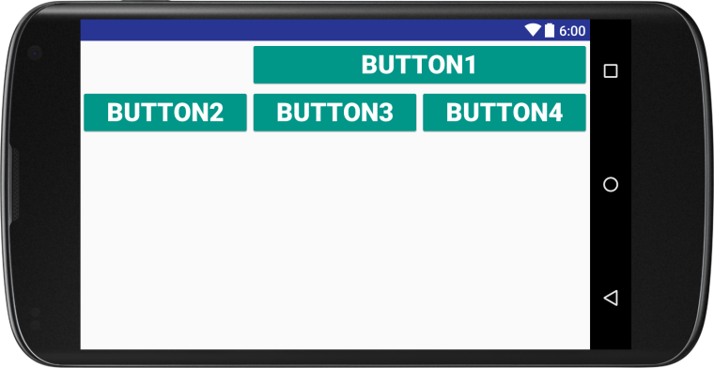
Layout Managers: TableLayout
Elements are placed in rows and columns. Each row is set by tag TableRow. Number of columns calculated basing on number of rows.
Element can occupy several cells: android:layout_span="2"
You can specify exact column for the element
android:layout_column="1"
By default cell width is chosen in order to have enough space for the element, but you can choose this:
android:stretchColumns="*“
and vice versa (add scrolling): android:shrinkColumns="1,2"
Collapse columns: android:collapseColumns="0"
<TableLayout android:layout_width="match_parent" android:layout_height="match_parent" android:stretchColumns="*"> <TableRow> <Button android:text="Button1" android:layout_column="1" android:layout_span="2"/> </TableRow> <TableRow> <Button android:text="Button2"/> <Button android:text="Button3"/> <Button android:text="Button4"/> </TableRow> </TableLayout>

Slide 39
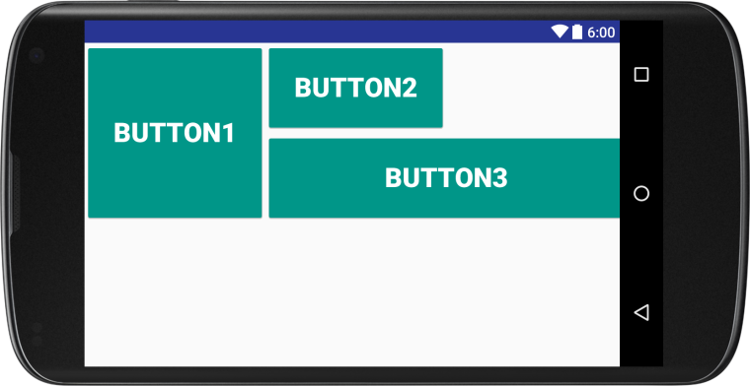
Layout Managers: GridLayout
You need to specify row and column for each component
android:layout_column="1" android:layout_row="1"
Components can be spanned across multiple grid cells:
android:layout_rowSpan="2"
<GridLayout android:layout_width="match_parent" android:layout_height="match_parent"> <Button android:layout_width="200dp" android:layout_height="200dp" android:text="Button1" android:layout_column="0" android:layout_row="0" android:layout_rowSpan="2"/> <Button android:layout_width="200dp" android:layout_height="100dp" android:text="Button2" android:layout_column="1"/> <Button android:layout_width="400dp" android:layout_height="100dp" android:text="Button3" android:layout_column="1" android:layout_row="1"/> </GridLayout>

Slide 40

Layout Managers: ConstraintLayout

Slide 41
Adapters

Slide 42
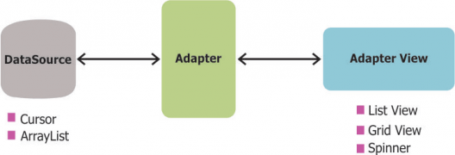
Adapters
Adapters in Android are a bridge between the Adapter View (e.g. ListView) and the underlying data for that view
ArrayAdapter arrayAdapter = new ArrayAdapter<String>(сontext, android.R.layout.simple_list_item_1, array);
Parameters:
context – usually ref to Activity
array – data array
resourceID – resource identifier (Android has built-in system resources, e.g. simple_list_item_1)
Adapters call the getView() method which returns a view for each item within the adapter view. The layout format and the corresponding data for an item within the adapter view is set in the getView() method.
Other adapters:
CursorAdapter – converts Cursor, received from ContentProvider
SimpleAdapter – converts data, received from XML-file

Slide 43
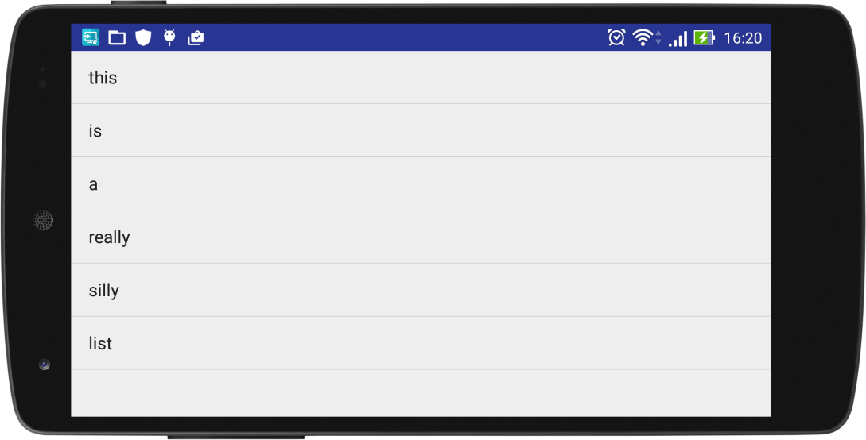
Adapters: ListActivity
public class MainActivity extends ListActivity { @Override protected void onCreate(Bundle savedInstanceState) { super.onCreate(savedInstanceState); String[ ] array = {"this", "is", "a", "really", "silly", "list"}; ArrayAdapter arrayAdapter = new ArrayAdapter<>(this, android.R.layout.simple_list_item_1, array); setListAdapter(arrayAdapter); } @Override protected void onListItemClick(ListView list, View view, int position, long id) { super.onListItemClick(list, view, position, id); } }
ListSample

Slide 44
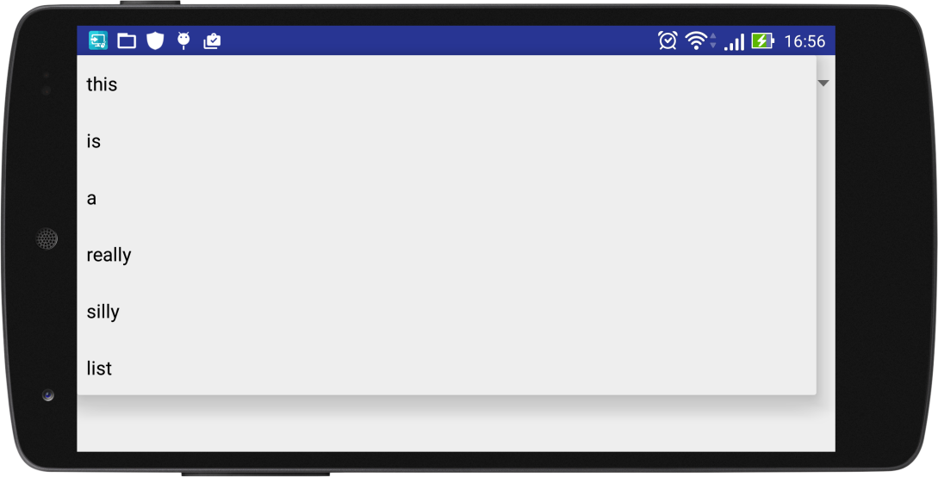
Adapters: Spinner
public class MainActivity extends Activity { @Override protected void onCreate(Bundle savedInstanceState) { super.onCreate(savedInstanceState); setContentView(R.layout.test);
Spinner spinner = (Spinner) findViewById(R.id.spinner); String[ ] array = {"this", "is", "a", "really", "silly", "list"}; ArrayAdapter arrayAdapter = new ArrayAdapter<>(this, android.R.layout.simple_list_item_1, array);
ArrayAdapter.setDropDownViewResource(android.R.layout.simple_spinner_dropdown_item); spinner.setAdapter(arrayAdapter); } }
SpinnerSample

Slide 45
RecyclerView control - Overview
RecyclerView is a UI component which allows us to create scrolling list.
To implement a RecyclerView we have to create the following:
a RecyclerView which we should add to our screen layout,
a layout for each row in the list,
an adapter which holds the data and binds them to the list.
The views in the list are represented by view holder objects. These objects are instances of a class you define by extending RecyclerView.ViewHolder. Each view holder is in charge of displaying a single item with a view. For example, if your list shows music collection, each view holder might represent a single album. The RecyclerView creates only as many view holders as are needed to display the on-screen portion of the dynamic content, plus a few extra. As the user scrolls through the list, the RecyclerView takes the off-screen views and rebinds them to the data which is scrolling onto the screen.

Slide 46
RecyclerView control - add the support library
To access the RecyclerView widget, you need to add the v7 Support Libraries to your project as follows:
Open the build.gradle file for your app module.
Add the support library to the dependencies section.
dependencies {
implementation 'com.android.support:recyclerview-v7:28.0.0'
}

Slide 47
RecyclerView control - add to the layout
<?xml version="1.0" encoding="utf-8"?>
<android.support.constraint.ConstraintLayout
xmlns:android="http://schemas.android.com/apk/res/android"
xmlns:app="http://schemas.android.com/apk/res-auto"
xmlns:tools="http://schemas.android.com/tools"
android:layout_width="match_parent"
android:layout_height="match_parent"
tools:context=".MainActivity">
<android.support.v7.widget.RecyclerView
android:id="@+id/my_recycler_view"
android:scrollbars="vertical"
android:layout_width="match_parent"
android:layout_height="match_parent"/>
</android.support.constraint.ConstraintLayout>

Slide 48
RecyclerView control - add to the activity
On the created RecyclerView instance we have to set a LayoutManager. A LayoutManager is responsible for measuring and positioning item views within a RecyclerView as well as determining the policy for when to recycle item views that are no longer visible to the user. So basically, it means that the LayoutManager is layouting the list in a chosen way.
@Override
protected void onCreate(Bundle savedInstanceState) {
super.onCreate(savedInstanceState);
setContentView(R.layout.activity_main);
mRecyclerView = (RecyclerView) findViewById(R.id.my_recycler_view);
mRecyclerView.setLayoutManager(new LinearLayoutManager(this));
}

Slide 49
RecyclerView control - create a list row layout
The list row layout is pretty simple — some image and a text next to it. To make that happen we used LinearLayout with horizontal orientation.
<?xml version="1.0" encoding="utf-8"?>
<LinearLayout xmlns:android="http://schemas.android.com/apk/res/android"
xmlns:tools="http://schemas.android.com/tools"
android:orientation="vertical" android:layout_width="match_parent"
android:layout_height="match_parent">
<ImageView
android:layout_width="32dp"
android:layout_height="32dp"
android:src = "@mipmap/ic_launcher"/>
<TextView
android:layout_width="wrap_content"
android:layout_height="wrap_content"
android:layout_marginStart="8dp"
android:id = "@+id/text_item"
tools:text="ExampleList"/>
</LinearLayout>

Slide 50
RecyclerView control - create view holder
The ViewHolder prevents unnecessary findViewById() calls on each bind.
public class MyViewHolder extends RecyclerView.ViewHolder {
public TextView mTextView;
public MyViewHolder(View v) {
super(v);
mTextView = v.findViewById(R.id.text_item);
}
}

Slide 51
RecyclerView control - create adapter
We have to create a class which extends RecyclerView.Adapter which as a parameters takes a class which extends RecyclerView.ViewHolder. Another thing is to override some needed methods.
What are these methods doing?
getItemCount() returns the total number of the list size. The list values are passed by the constructor.
onCreateViewHolder() creates a new ViewHolder object whenever the RecyclerView needs a new one. This is the moment when the row layout is inflated, passed to the ViewHolder object and each child view can be found and stored.
onBindViewHolder() takes the ViewHolder object and sets the proper list data for the particular row on the views inside.

Slide 52
RecyclerView control - create adapter
public class CustomAdapter extends RecyclerView.Adapter<MyViewHolder> {
private ArrayList<String> mDataset;
// Return the size of your dataset (invoked by the layout manager)
@Override
public int getItemCount() {
return mDataset.size();
}
public MyViewHolder onCreateViewHolder (ViewGroup parent, int ViewType) {
View view = LayoutInflater.from(parent.getContext()).inflate(R.layout.list_item_view, parent, false);
Log.d("Adapter", "OnCreateViewHolder");
return new MyViewHolder(view);
}
public void onBindViewHolder(MyViewHolder vh, int position) {
Log.d("Adapter", "OnBindViewHolder for position: " + position);
vh.mTextView.setText(mDataset.get(position));
}
// Provide a suitable constructor (depends on the kind of dataset)
public CustomAdapter(ArrayList<String> myDataset) {
mDataset = myDataset;
}
}

Slide 53
RecyclerView control – set adapter to activity
@Override
protected void onCreate(Bundle savedInstanceState) {
super.onCreate(savedInstanceState);
setContentView(R.layout.activity_main);
mRecyclerView = (RecyclerView) findViewById(R.id.my_recycler_view);
mRecyclerView.setLayoutManager(new LinearLayoutManager(this));
mRecyclerView.setAdapter(new CustomAdapter(generateContent()));
}
private ArrayList<String> generateContent() {
ArrayList <String> content = new ArrayList<String>();
for (int i=0; i<50; i++) {
content.add("Element number " + i);
}
return content;
}
RecyclerViewSample

Slide 54
RecyclerView control – reusable views
Add some logging to understand behavior of RecyclerView
public MyViewHolder onCreateViewHolder (ViewGroup parent, int ViewType) {
View view = LayoutInflater.from(parent.getContext()).inflate(R.layout.list_item_view, parent, false);
Log.d("Adapter", "OnCreateViewHolder");
return new MyViewHolder(view);
}
public void onBindViewHolder(MyViewHolder vh, int position) {
Log.d("Adapter", "OnBindViewHolder for position: " + position);
vh.mTextView.setText(mDataset.get(position));
}

Slide 55
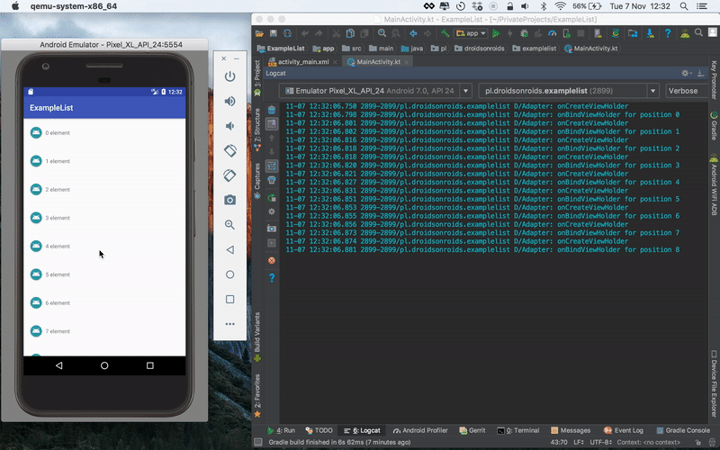
RecyclerView control – reusable views
onCreateViewHolder() method is called and ViewHolder objects are created for a couple of first views and then the created ones are reusing and the adapter is just binding the data with the onBindViewHolder() method. Thanks to that the list is very efficient and user can scroll the list smoothly, because the most costly calls (like inflating and finding views) are happening inside the onCreateViewHolder() method.

Slide 56
Build a UI with Android Layout Editor

Slide 57
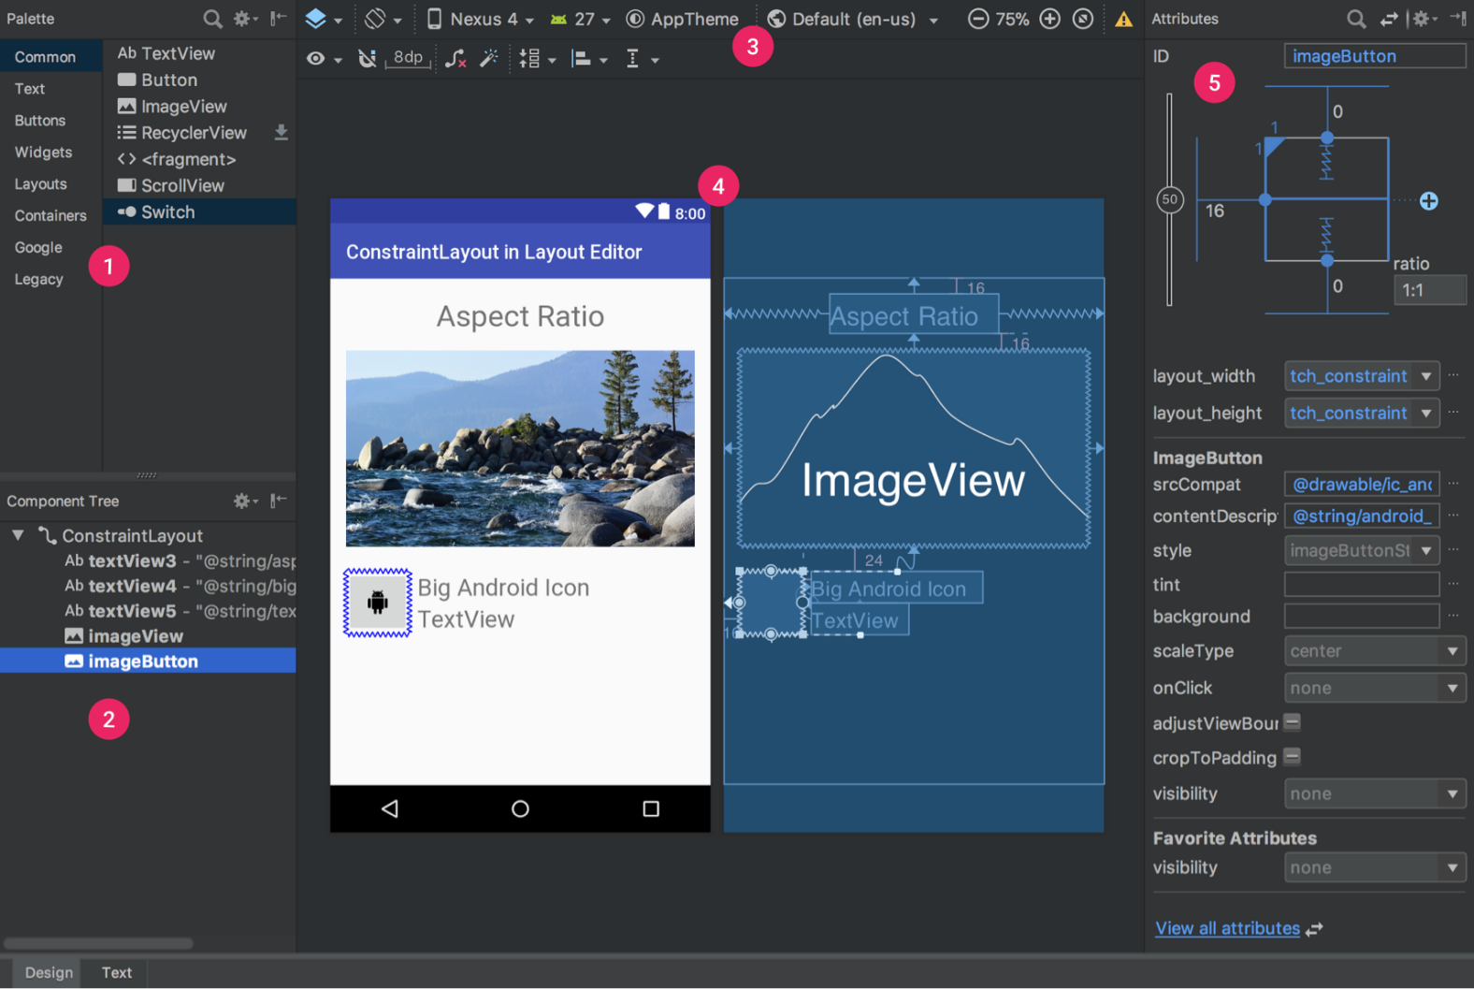
Main Window
1 - Palette: List of views and view groups that you can drag into your layout.
2 - Component Tree: View hierarchy for your layout.
3 - Toolbar: Buttons to configure your layout appearance in the editor and to change some layout attributes.
4 - Design editor: Layout in Design or Blueprint view, or both.
5 - Attributes: Controls for the selected view's attributes.
7
7 - Mode Switching - Design/Text: switch to Text mode to see the content of the XML file along with the preview. At any time during the design process, the underlying XML can be viewed and directly edited simply by clicking on the Text tab located at the bottom of the Designer tool panel.

Slide 58
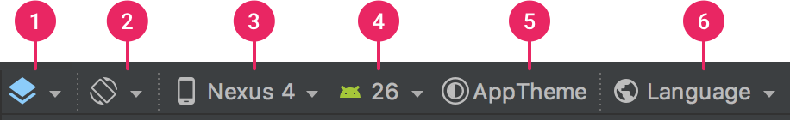
Change the preview appearance
1 - Design and blueprint: Select how you'd like to view your layout in the editor; select either the Design view (a real-world preview of your layout), the Blueprint view (only outlines for each view), or Design + Blueprint for both side by side.
2 - Screen orientation and layout variants: Select between landscape and portrait screen orientation, or other screen modes for which your app provides alternative layouts, such as night mode. This menu also contains commands for creating a new layout variant.
3 - Device type and size: Select the device type (phone/tablet, Android TV, or Wear OS) and screen configuration (size and density). You can select from several pre-configured device types and your own AVD definitions, or start a new AVD by selecting Add Device Definition from the list.
4 - API version: Select the version of Android on which to preview your layout.
5 - App theme: Select which UI theme to apply to the preview. (This works only for supported layout styles; thus many themes in this list result in an error.)
6 - Language: Select the language to show for your UI strings. This list displays only the languages available in your string resources. If you'd like to edit your translations, click Edit Translations from the drop-down menu (see Localize the UI with Translations Editor).

Slide 59
Create a new layout
In the Project window, click the module (such as app) in which you want to add a layout.
In the main menu, select File > New > XML > Layout XML File.
In the dialog that appears, enter a name for the file, the root layout tag, and the source set in which the layout belongs. Then click Finish.
OR
If you've selected the Project view in the Project window: open the res directory for your app module, right-click the layout directory where you'd like to add the layout and then click New > Layout resource file.
OR
If you've selected the Android view in the Project window: right-click the layout folder and then select New > Layout resource file.

Slide 60
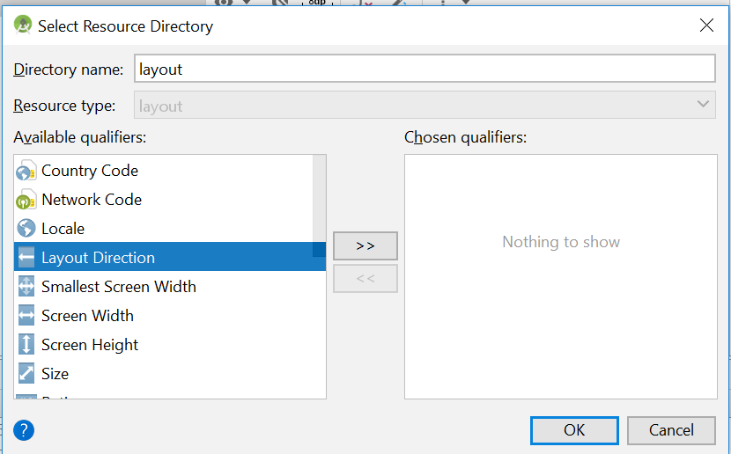
Create a layout variant
Open your original layout file and be sure you're viewing the design editor (click the Design tab at the bottom of the window).
Click Orientation for Preview in the toolbar. In the dropdown list, either click a suggested variant such as Create Landscape Variant and you're done, or click Create Other and continue to the next step.
In the dialog that appears, you simply need to define the resource qualifiers for the directory name. You can type it in Directory name or select from the Available qualifiers list, one at a time, and click Add .
Once you've added all your qualifiers, click OK.

Slide 61
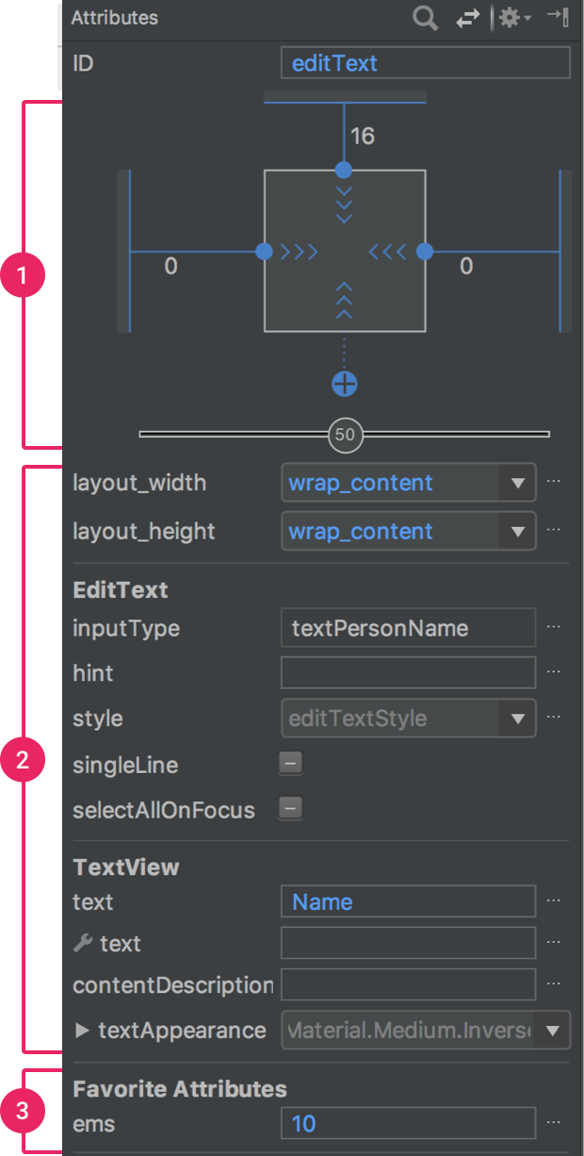
Add views and Edit view attributes
To start building your layout, simply drag views and view groups from the Palette into the design editor. As you place a view in the layout, the editor the editor displays information about the view's relationship with the rest of the layout.
1 - View inspector with controls for width/height style, margins, and bias (available only for views in a ConstraintLayout).
2 - A list of common attributes for the selected view. To see all available attributes, click View all attributes at the top of the window.
3 - Favorite attributes you've selected. To add attributes, click View all attributes and then click the star that appears when you hover your mouse over the left side of a attribute name.

Slide 62
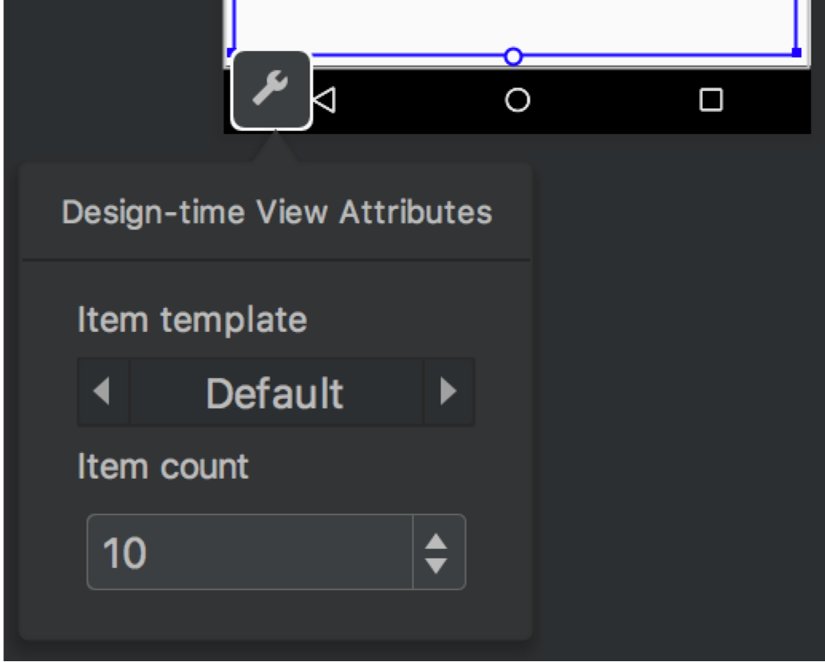

Add sample data to your view
In Android Studio 3.2 and later, you can add sample preview data to a TextView, an ImageView, or a RecyclerView from within the Layout Editor.
When you hover your mouse over a view, the design-time attributes button appears below the view in the Design window. Click this button to display the Design-time View Attributes window.
When you add sample data to a View, Android Studio makes changes to your project as though you were using your own data. You can then modify these changes as needed.

Slide 63
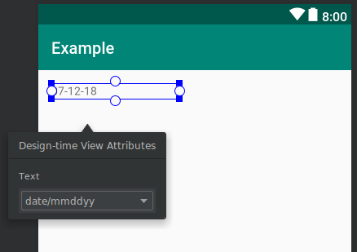
Add sample data to your view - TextView
In a TextView, you can choose between different sample text categories. When using sample text, Android Studio populates the text attribute of the TextView with your chosen sample data. Note that you can choose sample text via the Design-time View Attributes window only if the text attribute is empty.

Slide 64
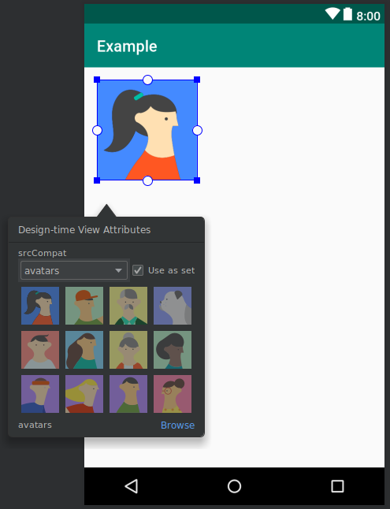
Add sample data to your view - ImageView
In an ImageView, you can choose between different sample images. When you choose a sample image, Android Studio populates the tools:src attribute of the ImageView (or tools:srcCompat if using the Support Library).

Slide 65
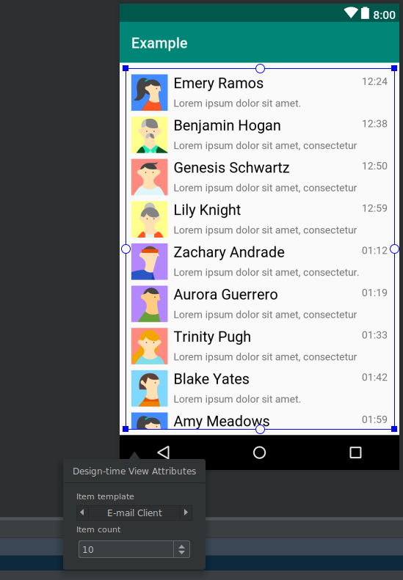
Add sample data to your view - RecyclerView
In a RecyclerView, you can choose between a set of templates that contain sample images and texts. When using these templates, Android Studio adds a file to your res/layout directory, recycler_view_item.xml, that contains the layout for the sample data. Android Studio also adds metadata to the RecyclerView to properly display the sample data.

Slide 66
Support different screen sizes and pixel densities

Slide 67
Overview
Screen sizes:
Flexible layouts
Alternative layouts
Stretchable images
Screen densities:
Density independence
Alternative bitmaps
Vector graphics

Slide 68
Screen sizes: flexible layouts
Use ConstraintLayout as the base layout in your UI.
Avoid hard-coded layout sizes
Specify “wrap_content” and “match_parent” instead of hard-coded sizes. When using ConstraintLayout don’t use “match_parent”, instead, set the dimension to 0dp to enable a special behavior called "match constraints"

Slide 69
Screen sizes: alternative layouts
Provide screen-specific layouts by creating additional res/layout/ directories—one for each screen configuration that requires a different layout—and then append a screen configuration qualifier to the layout directory name. E.g. use the smallest width qualifier (sw) which specifies the smallest of the screen's two sides, regardless of the device's current orientation, so it's a simple way to specify the overall screen size available for your layout.
Here's how other smallest width values correspond to typical screen sizes:
320dp: a typical phone screen (240x320 ldpi, 320x480 mdpi, 480x800 hdpi, etc).
480dp: a large phone screen ~5" (480x800 mdpi).
600dp: a 7” tablet (600x1024 mdpi).
720dp: a 10” tablet (720x1280 mdpi, 800x1280 mdpi, etc).
res/layout/main_activity.xml # For handsets (smaller than 600dp available width)
res/layout-sw600dp/main_activity.xml # For 7” tablets (600dp wide and bigger)
You might want to change your layout based on how much width or height is currently available. In this case, you should use the "available width" qualifier as follows:
res/layout/main_activity.xml # For handsets (smaller than 600dp available width)
res/layout-w600dp/main_activity.xml # For 7” tablets or any screen with 600dp available width (possibly landscape)

Slide 70
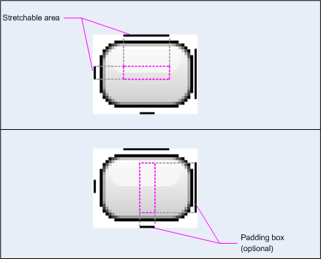
Screen sizes: stretchable nine-patch bitmaps
A nine-patch bitmap is basically a standard PNG file, but with an extra 1px border that indicates which pixels should be stretched (and with a .9.png extension instead of just .png). As shown below, the intersection between the black lines on the left and top edge is the area of the bitmap that can be stretched.
Optionally, you can also define the safe region where content should go inside the view by similarly adding lines on the right and bottom edges.

Slide 71

Screen densities
https://www.youtube.com/watch?v=zhszwkcay2A&t=131s

Slide 72
Fragments

Slide 73
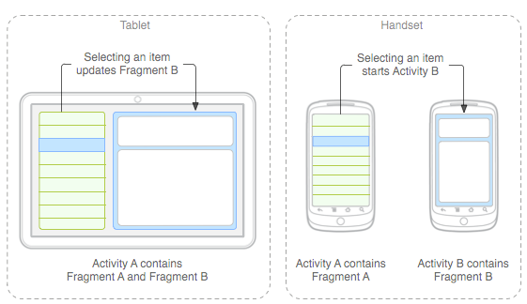
Fragments
A Fragment (starting from Android 3.0) represents a behavior or a portion of user interface in an Activity. You can combine multiple fragments in a single activity to build a multi-pane UI and reuse a fragment in multiple activities. You can think of a fragment as a modular section of an activity, which has its own lifecycle, receives its own input events, and which you can add or remove while the activity is running (sort of like a "sub activity" that you can reuse in different activities)
Reasons to use:
Re-use parts of UI
Possibility to create easily different UI for smartphones and tablets

Slide 74
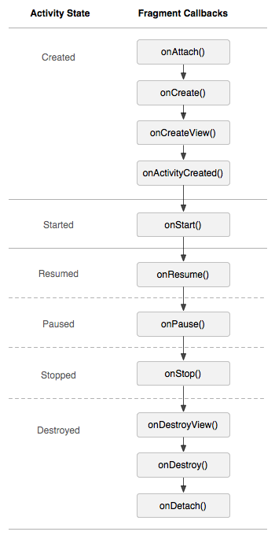
Fragments
Fragment has its own UI (views and layouts)
Fragment can’t exist without Activity
Activity can contain several fragments
Fragment has own lifecycle connected with Activity lifecycle
FragmentLifecycle

Slide 75
Fragments: Creation
public class ListFragment extends Fragment { FragmentListener mListener; @Override public View onCreateView(LayoutInflater inflater, ViewGroup container, Bundle savedInstanceState) { return inflater.inflate(R.layout.fragment_list, container, false); } @Override public void onAttach(Activity activity) { super.onAttach(activity); try { mListener = (FragmentListener) activity; } catch (ClassCastException e) { throw new ClassCastException(activity.toString() + " must implement FragmentListener"); } } }

Slide 76
Fragments: Add statically
<?xml version="1.0" encoding="utf-8"?> <LinearLayout xmlns:android="http://schemas.android.com/apk/res/android" xmlns:tools="http://schemas.android.com/tools" android:layout_width="match_parent" android:layout_height="match_parent"> <fragment android:id="@+id/list" android:name="com.example.todolist.ListFragment" android:layout_width="match_parent" android:layout_height="match_parent" tools:layout="@layout/fragment_list"/> </LinearLayout>
ListFragment fragment = (ListFragment) getSupportFragmentManager().findFragmentById(R.id.list);

Slide 77
Fragments: Add dynamically
<?xml version="1.0" encoding="utf-8"?> <FrameLayout android:id="@+id/container" android:layout_width="match_parent" android:layout_height="match_parent"/>
Fragment fragment = new ListFragment(); FragmentTransaction fragmentTransaction = getSupportFragmentManager().beginTransaction(); fragmentTransaction.add(R.id.container, fragment, "List"); fragmentTransaction.commit();
ListFragment fragment = (ListFragment) getSupportFragmentManager().findFragmentById(R.id.container); ListFragment fragment = (ListFragment) getSupportFragmentManager().findFragmentByTag("List");
FragmentDynamic

Slide 78
Fragments: Retain Configuration Change
If restarting your activity requires that you recover large sets of data, re-establish a network connection, or perform other intensive operations, then a full restart due to a configuration change might be a slow user experience.
In such a situation, you can alleviate the burden of reinitializing part of your activity by retaining a Fragment when your activity is restarted due to a configuration change. This fragment can contain references to stateful objects that you want to retain.
When the Android system shuts down your activity due to a configuration change, the fragments of your activity that you have marked to retain are not destroyed. You can add such fragments to your activity to preserve stateful objects.
To retain stateful objects in a fragment during a runtime configuration change:
Extend the Fragment class and declare references to your stateful objects.
Call setRetainInstance(boolean) when the fragment is created.
Add the fragment to your activity.
Use FragmentManager to retrieve the fragment when the activity is restarted.

Slide 79
Fragments: Retain Configuration Change
public class RetainedFragment extends Fragment { // data object we want to retain private MyDataObject data; // this method is only called once for this fragment @Override public void onCreate(Bundle savedInstanceState) { super.onCreate(savedInstanceState); // retain this fragment setRetainInstance(true); } public void setData(MyDataObject data) { this.data = data; } public MyDataObject getData() { return data; } }
While onCreate() is called only once when the retained fragment is first created you can se onAttach() or onActivityCreated() to know when the holding activity is ready to interact with this fragment.
And in your activity you can use this fragment to preserve states across configuration change restarts.

Slide 80
Fragments: Retain Configuration Change
public class MyActivity extends Activity { private static final String TAG_RETAINED_FRAGMENT = "RetainedFragment"; private RetainedFragment mRetainedFragment; @Override public void onCreate(Bundle savedInstanceState) { super.onCreate(savedInstanceState); setContentView(R.layout.main); // find the retained fragment on activity restarts FragmentManager fm = getFragmentManager(); mRetainedFragment = (RetainedFragment) fm.findFragmentByTag(TAG_RETAINED_FRAGMENT); // create the fragment and data the first time if (mRetainedFragment == null) { // add the fragment mRetainedFragment = new RetainedFragment(); fm.beginTransaction().add(mRetainedFragment, TAG_RETAINED_FRAGMENT).commit(); // load data from a data source or perform any calculation mRetainedFragment.setData(loadMyData()); } // the data is available in mRetainedFragment.getData() even after // subsequent configuration change restarts. } }
Then use FragmentManager to add the fragment to the activity. You can obtain the data object from the fragment when the activity starts again during runtime configuration changes. For example, define your activity as follows:

Slide 81
Fragments: Retain Configuration Change
In order to proactively remove the retained fragment when you no longer need it, you may check for isFinishing() in onPause() in the activity.
@Override public void onPause() { // perform other onPause related actions ... // this means that this activity will not be recreated now, user is leaving it // or the activity is otherwise finishing if(isFinishing()) { FragmentManager fm = getFragmentManager(); // we will not need this fragment anymore, this may also be a good place to signal // to the retained fragment object to perform its own cleanup. fm.beginTransaction().remove(mDataFragment).commit(); } }

